Slide 1
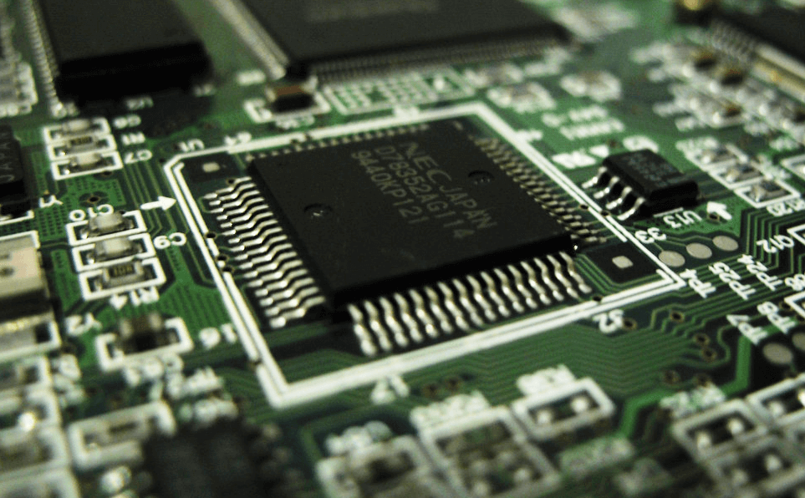
8085 Microprocessor
Dr. Manju Khurana
Assistant Professor, CSED
TIET, Patiala
manju.khurana@thapar.edu

Slide 2
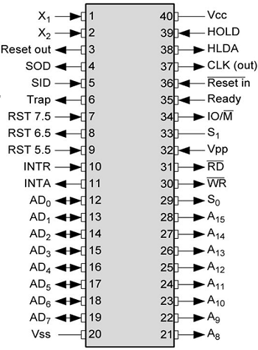
Pin Diagram of Intel 8085
Introduction to Microprocessor Based Systems Design
2

Slide 3
8085 Pin Description
Introduction to Microprocessor Based Systems Design
The 8085 is an 8-bit general purpose microprocessor that can address 64K Byte of memory.
It has 40 pins and uses +5V for power. It can run at a maximum frequency of 3 MHz.
The pins on the chip can be grouped into 9 groups:
Address Bus and Data Bus
Status Signals
Control signal
Interrupt signal
Power supply and Clock signal
Reset Signal
DMA request Signal
Serial I/O signal
Externally Initiated Signals.
3

Slide 4
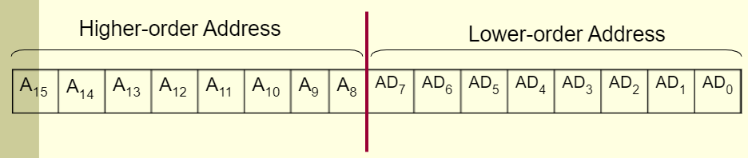
The Address and Data Busses
Introduction to Microprocessor Based Systems Design
Address Bus (Pin 21-28)
16 bit address lines A₀ to A₁₅
The address bus has 8 signal lines A₈ – A₁₅ which are unidirectional.
The other 8 address lines A₀ to A₇ are multiplexed (time shared) with the 8 data bits.
Data Bus (Pin 19-12)
To save the number of pins lower order address pin are multiplexed with 8 bit data bus (bidirectional)
So, the bits AD₀ – AD₇ are bi-directional and serve as A₀ – A₇ and D₀ – D₇ at the same time.
During the execution of the instruction, these lines carry the address bits during the early part (T₁ state), then during the late parts (T₂ state) of the execution, they carry the 8 data bits.
4

Slide 5
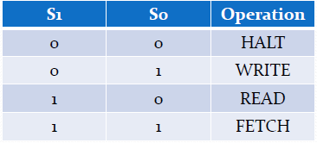
Status Signals
Introduction to Microprocessor Based Systems Design
Status Pins – ALE, S₁, S₀
ALE(Address Latch Enable) : (Pin 30)
Used to demultiplexed the address and data bus
+ve going pulse generated when a new operation is started by microprocessor.
ALE = 1 when the AD₀ – AD₇ lines have an address
ALE = 0 When it is low it indicates that the contents are data.
This signal can be used to enable a latch to save the address bits from the AD lines.
S₁ and S₀ (Status Signal) : (Pin 33 and 29)
Status signals to specify the kind of operation being performed .
Usually un-used in small systems.
5

Slide 6
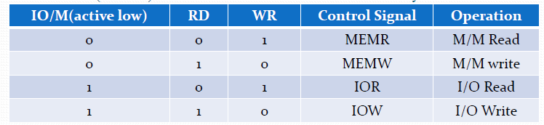
Control Signals
Introduction to Microprocessor Based Systems Design
Control Pins – RD, WR, IO/M (active low)
RD: Read (Active low) (Pin 32)
Read Memory or I/O device
Indicated that data is to be read either from memory or I/P device and data bus is ready for accepting data from the memory or I/O device.
WR: Write (Active low) (Pin 31)
Write Memory or I/O device
Indicated that data on the data bus are to be written into selected memory or I/P device.
IO/M: (Input Output/Memory-Active low) (Pin 34)
Signal specifies that the read/write operation relates to whether memory or I/O device.
When (IO/M=1) the address on the address bus is for I/O device
When (IO/M=0) the address on the address bus is for memory
6

Slide 7
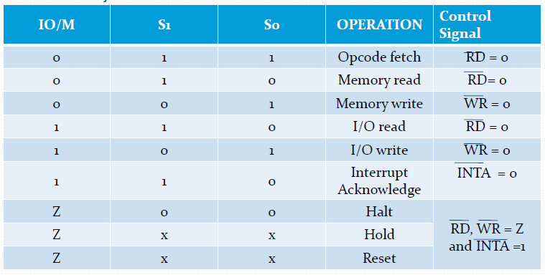
Control and status Signals
Introduction to Microprocessor Based Systems Design
When S₀, S₁ is combined with IO/M (active low), we get status of machine cycle
Z= Tristate, X = don’t care condition
7

Slide 8
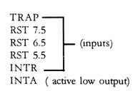
Interrupts
Introduction to Microprocessor Based Systems Design
They are the signals initiated by an external device to request the microprocessor to do a particular task or work.
There are five hardware interrupts called, (Pin 6-11)
On receipt of an interrupt, the microprocessor acknowledges the interrupt by the active low INTA (Interrupt Acknowledge) signal.
8

Slide 9
Power supply and Clock Signal
Introduction to Microprocessor Based Systems Design
Vcc (Pin 40) : single +5 volt power supply
Vss (Pin 20) : Ground
X₀ and X₁ : (Pin 1-2)
Crystal or R/C network or LC network connections to set the frequency of internal clock generator.
The frequency is internally divided by two.
Since the basic operating timing frequency is 3 MHz, a 6 MHz crystal is connected to the X₀ and X₁ pins.
CLK (output) : (Pin 37)
Clock Output is used as the system clock for peripheral and devices interfaced with the microprocessor.
9

Slide 10
Reset Signals
Introduction to Microprocessor Based Systems Design
Reset In (input, active low) (Pin 36)
This signal is used to reset the microprocessor.
The program counter inside the microprocessor is set to zero (0000H)
The buses are tri-stated.
Reset Out (Output, Active High) (Pin 3)
It indicates microprocessor is being reset.
Used to reset all the connected devices when the microprocessor is reset.
10

Slide 11
DMA Request Signals
Introduction to Microprocessor Based Systems Design
DMA:
When 2 or more devices are connected to a common bus, to prevent the devices from interfering with each other, the tristate gates are used to disconnect all devices except the one that is communicating at a given instant .
The CPU controls the data transfer operation between memory and I/O device.
DMA operation is used for large volume data transfer between memory and an I/O device directly.
The CPU is disabled by tri-stating its buses and the transfer is effected directly by external control circuits.
HOLD (Pin 38)
This signal indicates that another device is requesting the use of address and data bus.
So it relinquish the use of buses as soon as the current machine cycle is completed.
Microprocessor regains the bus after the removal of a HOLD signal
HLDA (Pin 39)
On receipt of HOLD signal, the MP acknowledges the request by sending out HLDA signal and leaves out the control of the buses.
After the HLDA signal the DMA controller starts the direct transfer of data.
After the removal of HOLD request HLDA goes low.
11

Slide 12
Serial I/O Signals
Introduction to Microprocessor Based Systems Design
These pins are used for serial data communication
SID (input) Serial input data (Pin 4)
It is a data line for serial input
Used to accept serial data bit by bit from external device
The data on this line is loaded into accumulator bit 7 whenever a RIM instruction is executed.
SOD (output) Serial output data (Pin 5)
It is a data line for serial output
Used to transmit serial data bit by bit to the external device
The 7th bit of the accumulator is outputted on SOD line when SIM instruction is executed.
12

Slide 13
Externally Initiated signal
Introduction to Microprocessor Based Systems Design
Ready (input) (Pin 35)
Memory and I/O devices will have slower response compared to microprocessors.
Before completing the present job such a slow peripheral may not be able to handle further data or control signals from CPU.
The processor sets the READY signal after completing the present job to access the data.
It synchronize slower peripheral to the processor.
The microprocessor enters into WAIT state while the READY pin is disabled.
13

Slide 14


